Slide 1

AIML CA2 Part A – Stock Price Forecasting
Randal Hong
DAAA/FT/1B/03
p2309248

Slide 2

Overview Of The Workflow
Check for duplicative data
Check for missing data
Fill missing data
Check for stationarity with ADF test
Transform non-stationary series to stationary series
Check for white noise with Ljung-Box test and ACF plot
View distribution of series with ETS decomposition
Initialise training and testing data
Model selection and hypertuning parameters
Model forecasting

Slide 3
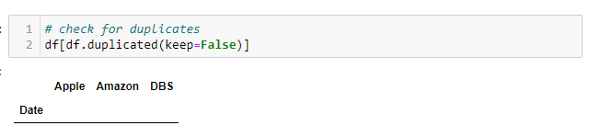



Data Preprocessing
Check for duplicative data
As the stock market closes on weekends and public holidays, we will fill in the missing dates in the dataset
Before:
After:

Slide 4
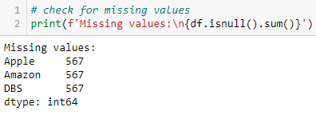

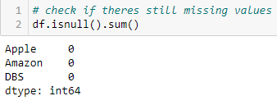
Data Preprocessing
Check for missing values
Use forward fill to impute missing values
Forward fill gets the previous date’s data

Slide 5
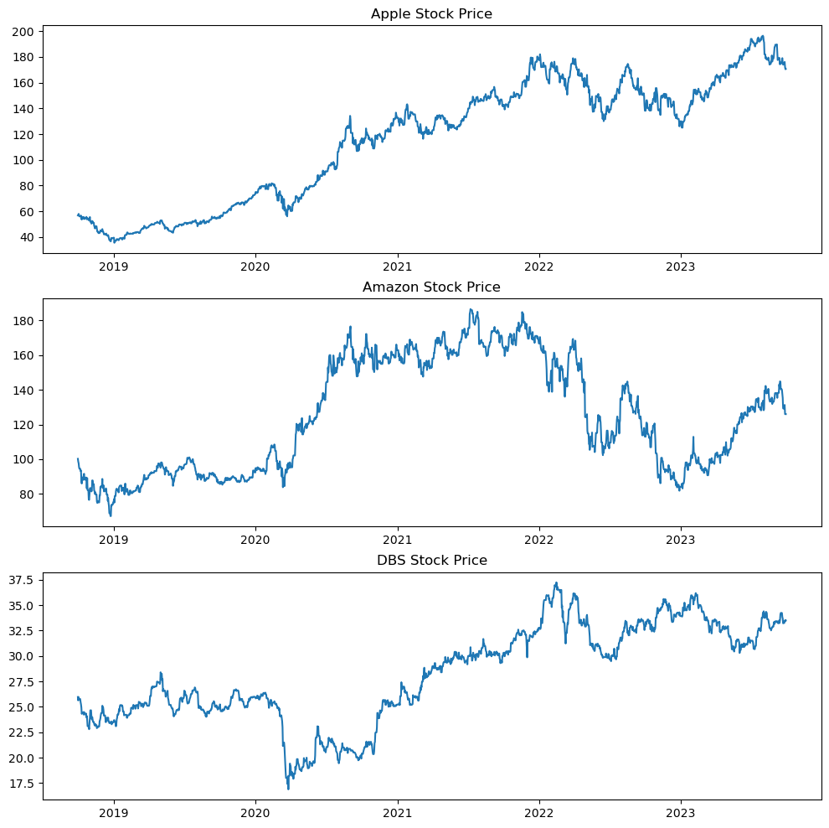
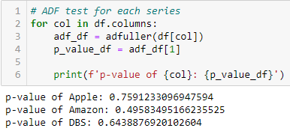
Data Preprocessing – Stationarity
Check for stationarity using ADF test
As p-value > 0.05, not stationary
Mean and variance does not look constant
Initially I thought of using returns (percentage change of current and previous day's price). However, I realised that the returns do not necessarily have a constant variance, so I decided to use log and/or differencing for each series

Slide 6
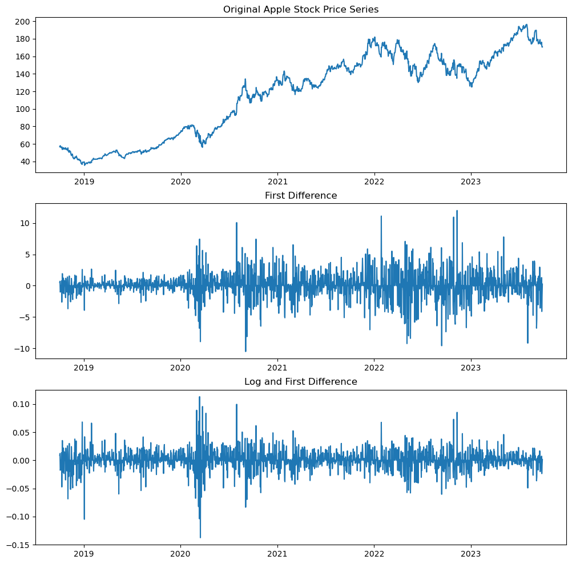
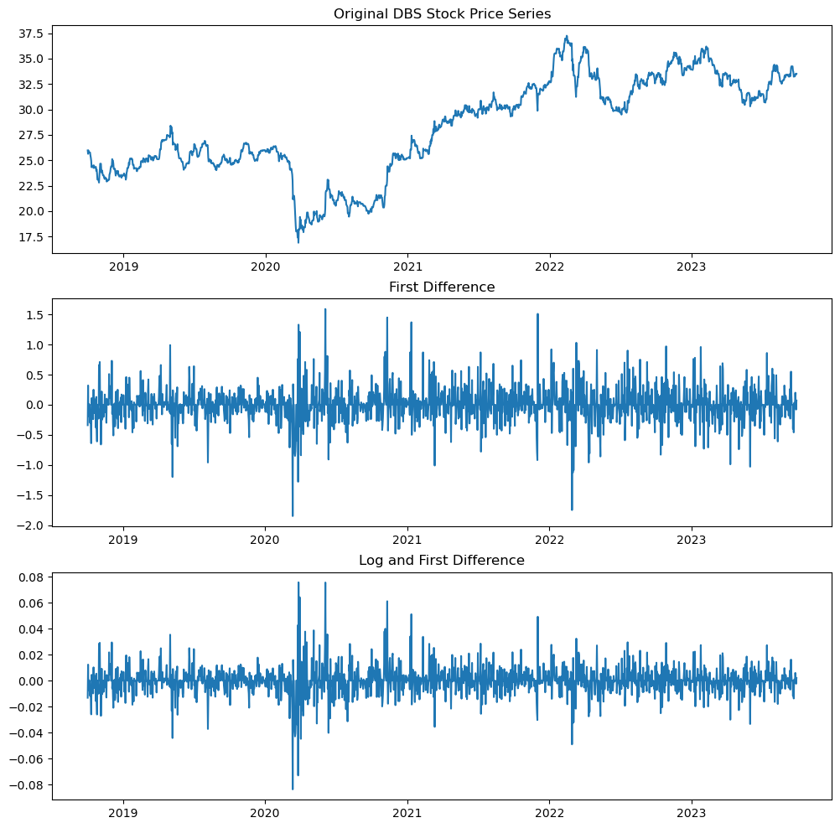
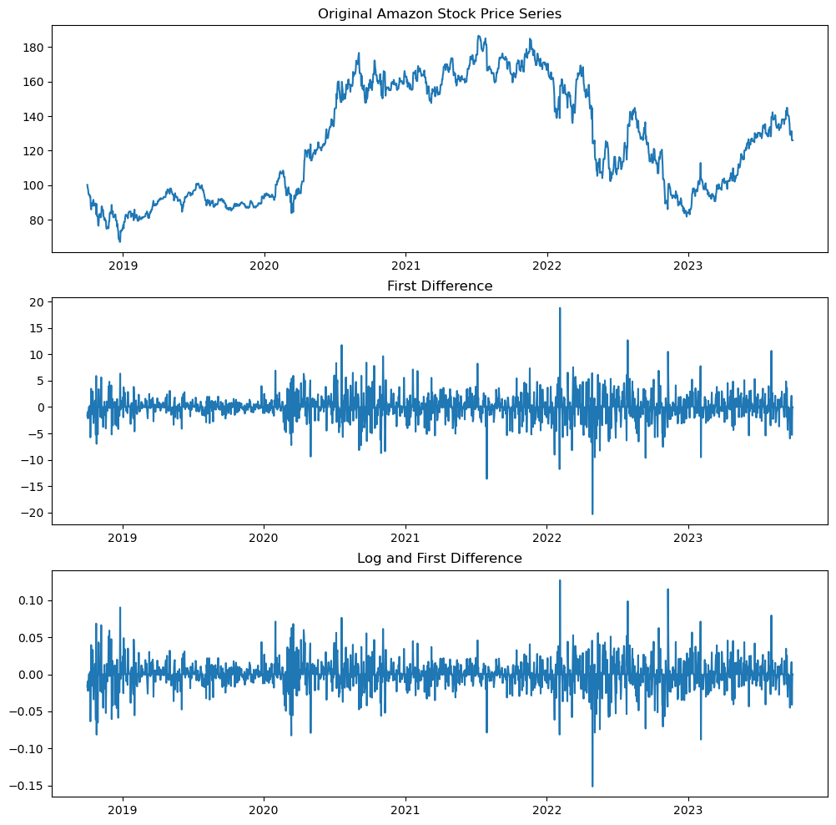
Data Preprocessing - Stationarity
As the first difference series and the log and first difference for each series look very similar, we will use ADF test to check whether they are stationary series and which has a lower p-value

Slide 7
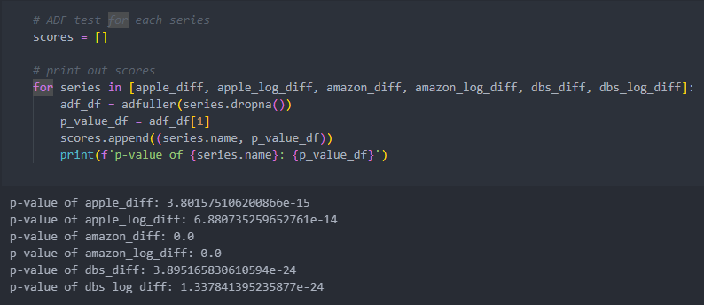
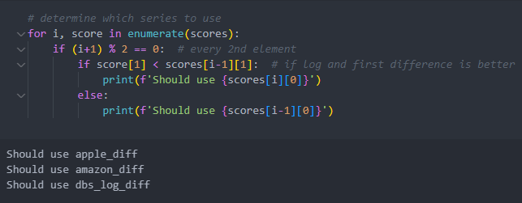
Data Preprocessing - Stationarity
As each series' p-value is already very low, we will not need to second-order or higher-order difference the series as there will not be much of a difference
We will choose which type of series with a lower p-value
Apple and Amazon with first order difference
DBS with log and first order difference

Slide 8
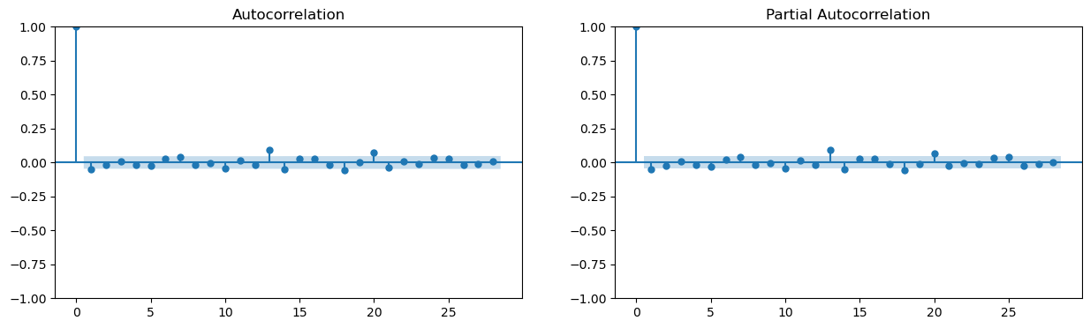

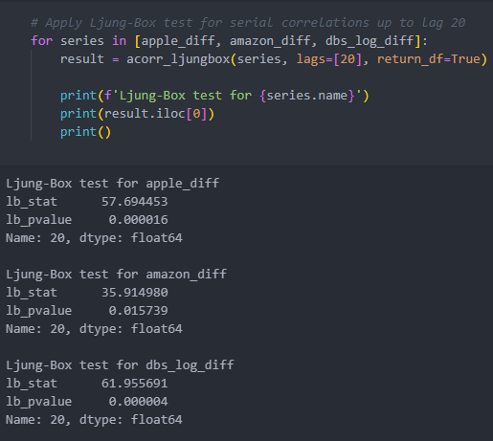
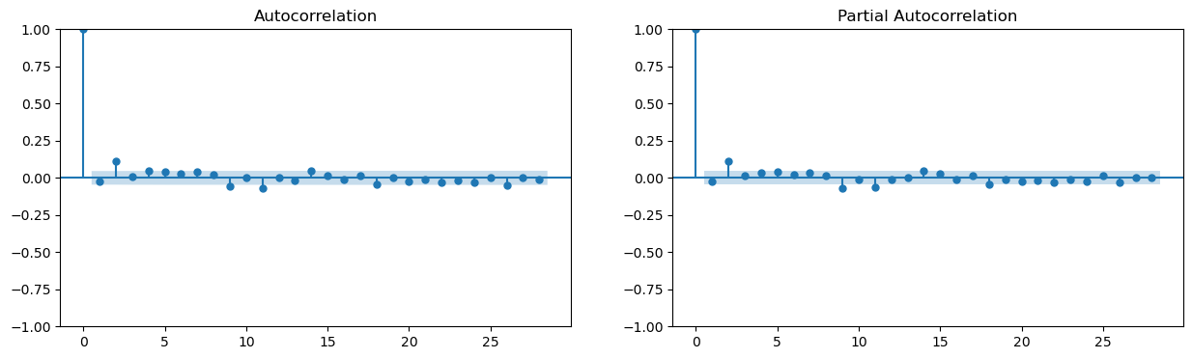
Data Preprocessing - Correlations
Apple
Check for autocorrelations using Ljung-Box test
Double check with ACF plot
Amazon
DBS

Slide 9
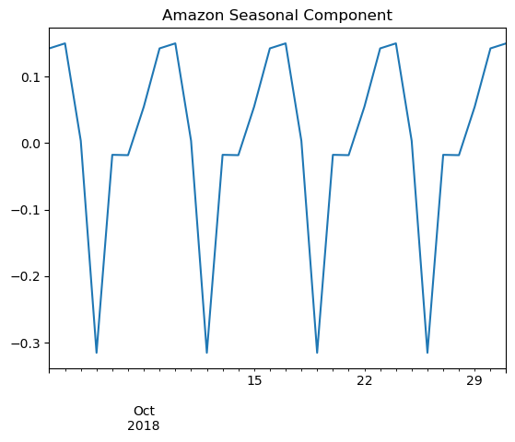
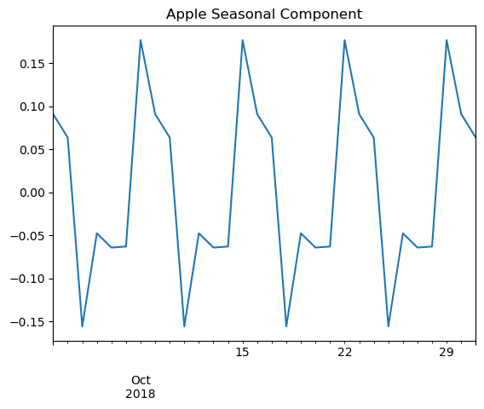
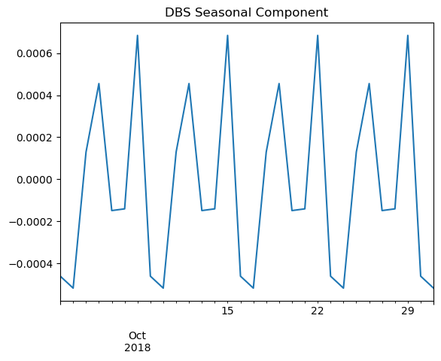
Data Preprocessing - Seasonality
Using an ETS decomposition plot, we can zoom in to view the seasonal trends
We can conclude that there is a weekly seasonal trend

Slide 10
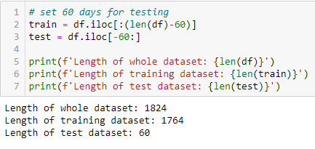
Model Building – Train Test Split
Split the data into training and testing component
As we want to forecast 60 days ahead, we will set the test data as the latest 60 days

Slide 11
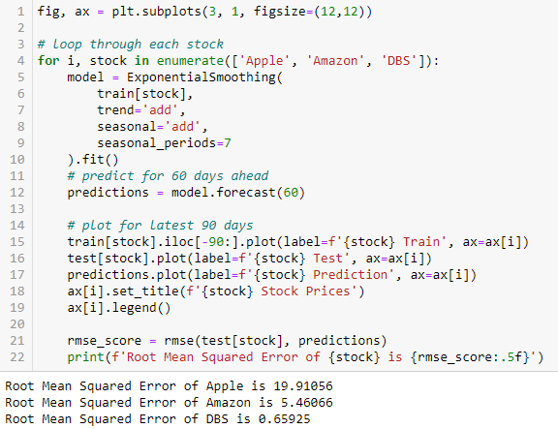
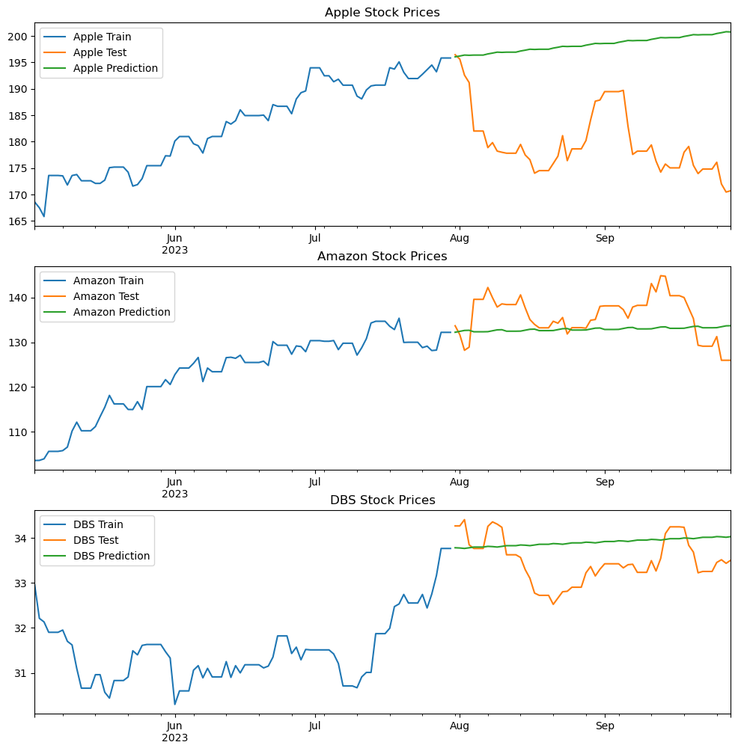
Model Building – Holt Winter’s
Holt Winter’s Exponential Smoothing model takes into account levels, trend and seasonality
However, it is quite simple as it predicted a fairly linear line
Although its RMSE score is very low especially for DBS, in the long run it will not be able to take into account for fluctuations
Hence we will not use Holt Winter’s

Slide 12
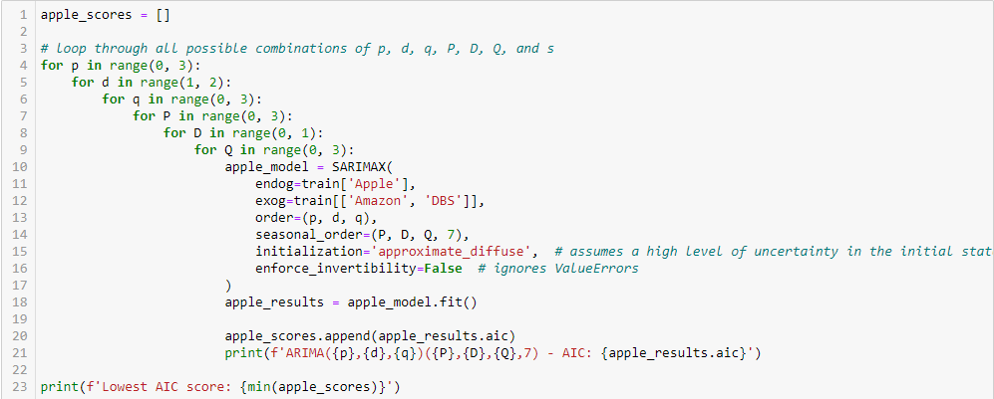
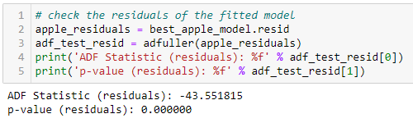
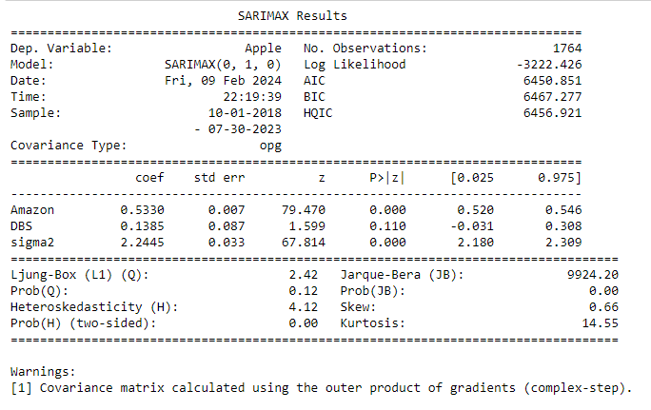
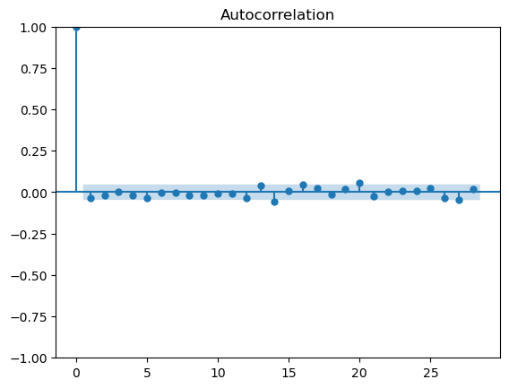
Model Building – SARIMAX (Apple)
Takes into account other data that can affect the target
In this case is Amazon and DBS as they are all in the same stock market and can influence one another
The best model has a high p-value for the Ljung-Box test and Heteroskedasticity test
Suggesting residuals are white noise and homoscedastic
ADF Test and ACF plot also shows the residuals are white noise

Slide 13
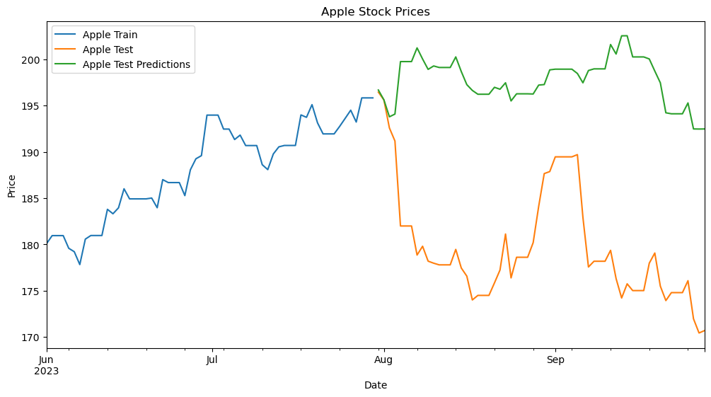

Model Evaluation – SARIMAX (Apple)
Test model on test data
RMSE of 19.12 means that the model is off by $19.12 on average
Model is decently good

Slide 14
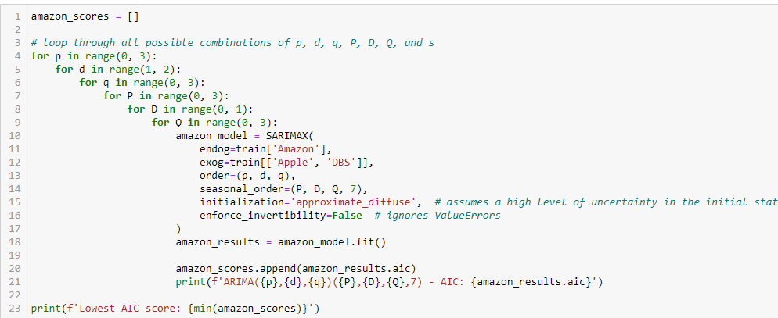
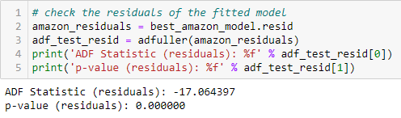
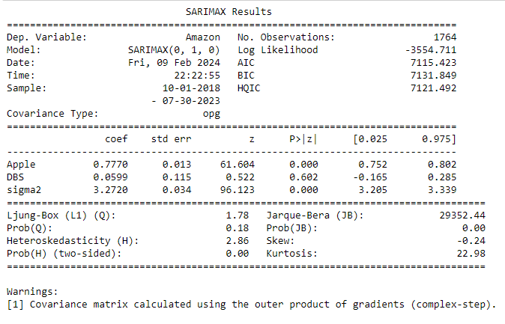
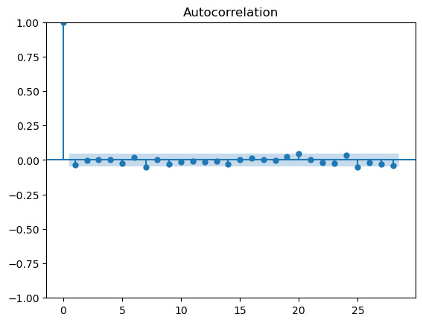
Model Building – SARIMAX (Amazon)
The best model has a high p-value for the Ljung-Box test and Heteroskedasticity test
Suggesting residuals are white noise and homoscedastic
ADF Test and ACF plot also shows the residuals are white noise

Slide 15
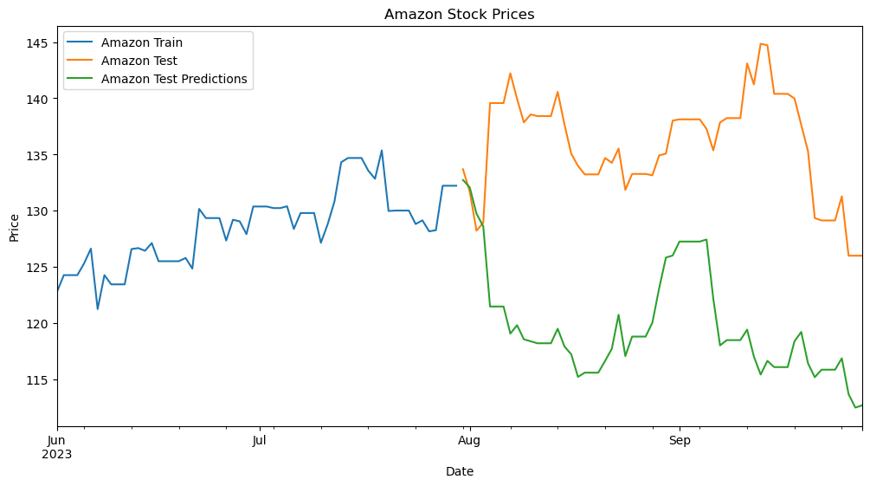

Model Evaluation – SARIMAX (Amazon)
Test model on test data
RMSE of 17.37 means that the model is off by $17.37 on average
Model is quite good

Slide 16
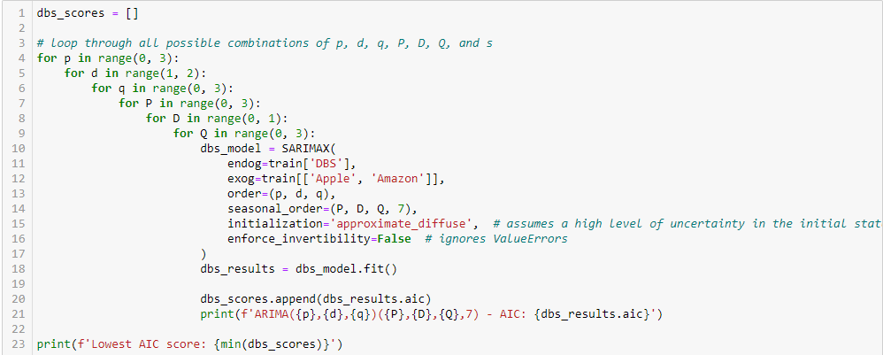
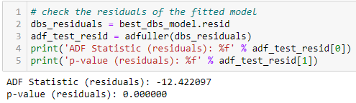
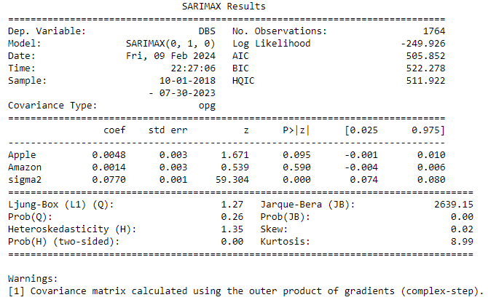
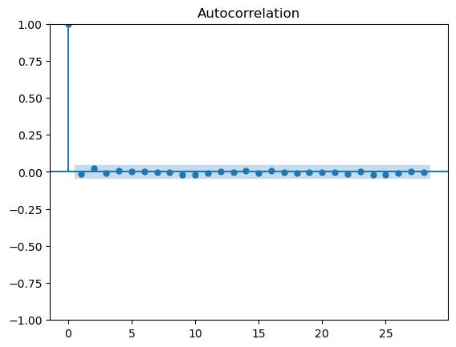
Model Building – SARIMAX (DBS)
The best model has a high p-value for the Ljung-Box test and Heteroskedasticity test
Suggesting residuals are white noise and homoscedastic
ADF Test and ACF plot also shows the residuals are white noise

Slide 17
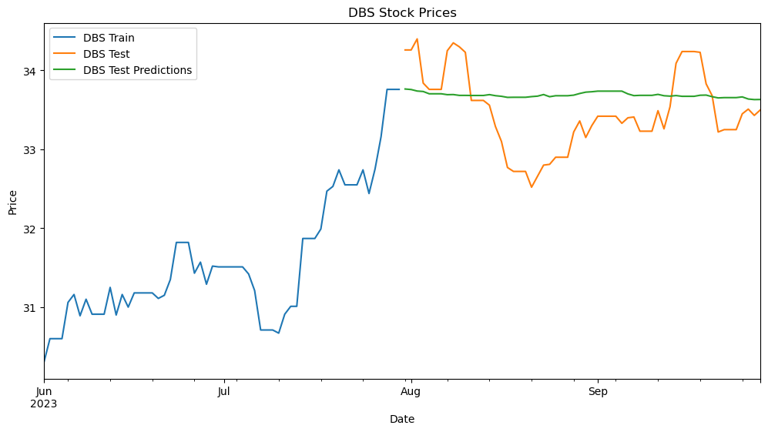

Model Evaluation – SARIMAX (DBS)
Test model on test data
RMSE of 0.53 means that the model is off by only $0.53 on average
Model is extremely good

Slide 18
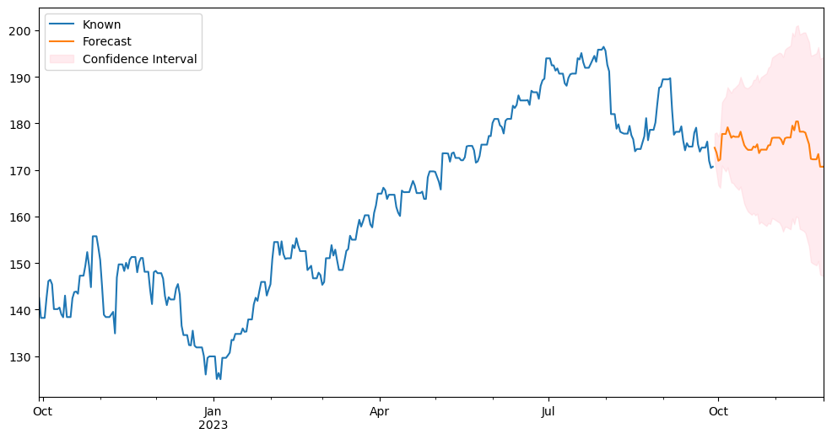
Model Forecasting – SARIMAX (Apple)
Forecast with entire dataset fitted into model
Shape of forecasted values is not linear
Decent despite the average RMSE score

Slide 19
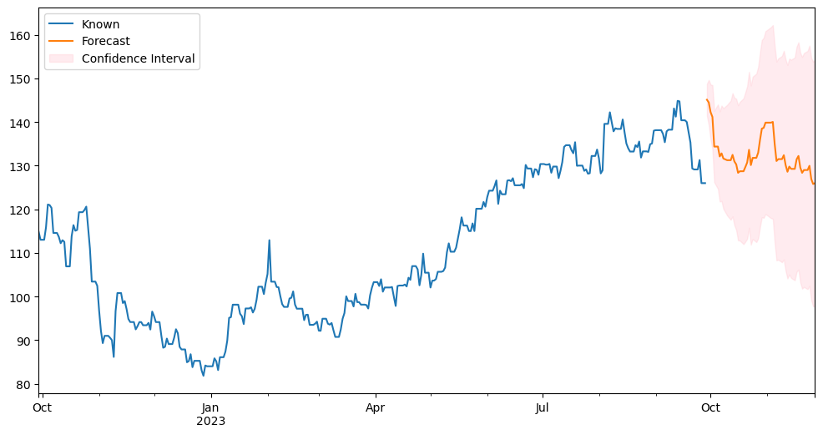
Model Forecasting – SARIMAX (Amazon)
Forecast with entire dataset fitted into model
Shape of forecasted values is not linear
Decent despite the average RMSE score

Slide 20
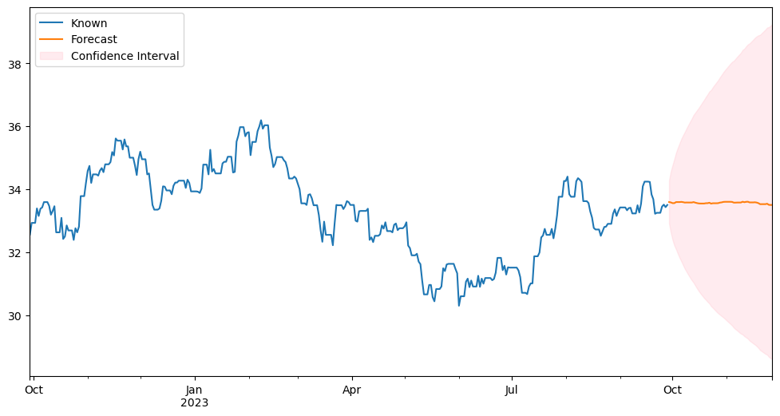
Model Forecasting – SARIMAX (DBS)
Forecast with entire dataset fitted into model
Surprisingly, although the DBS model had the lowest RMSE score, its prediction shape is a straight line
This could mean that the model overfitted to the training data and cannot take into account for future fluctuations
The reason why the DBS prediction is quite linear is because the seasonal pattern of the series (shown in ETS Decompostition) is really small in magnitude compared to the other stocks, hence the seasonality pattern does not have much influence in the prediction of the model

